Slide 1
Performance and Sales Insight for Ongoing projects
Pacific Lagos . Bellagio . Astoria
Vera Esate

Slide 2
Executive Summary
This analysis evaluate the performance of three of our real estate projects;
The Pacific Lagos, Bellagio, and Astoria
I used inquiry data, sales performance and marketing cost data to carryout the analysis.
Across the peroid analyzed, lead generations remain strong, driven by digital channels, referrals and exhibition.
The Pacific Lagos recorded the highest inquiry volume, supported by its strategic lagoon view location and strong brand presence,. Bellagio and Astoria maintained consistent engagement as well.
However, the conversion rate show a clear drop in finalized sales indicating gaps in follow-up and nurturing.
Marketing cost analysis reveals that Bellagio achieved the best ROI,this is due to the project value, though conversion rate was low. Pacific Lagos and Astoria also has good ROI. Astoria has the best conversion rate.
Overall, the data strongly suggests a need to improve sales follow-up cycles, refines leads acquisition strategies and optimize marketing allocation across projects.

Slide 3
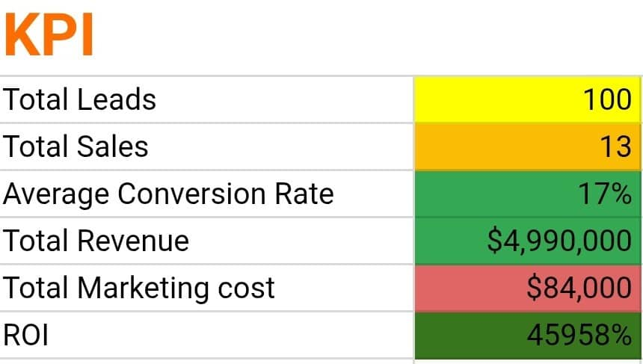

Slide 4
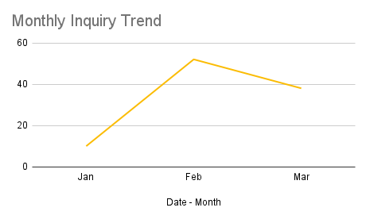
Total Inquiry Trend
This shows February has the highest Inquiry.

Slide 5
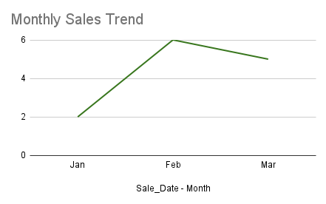
Sales Trend
This shows the month of February has high sales peak.
Sales drop a bit in March potentially due to a drop in Inquiry

Slide 6
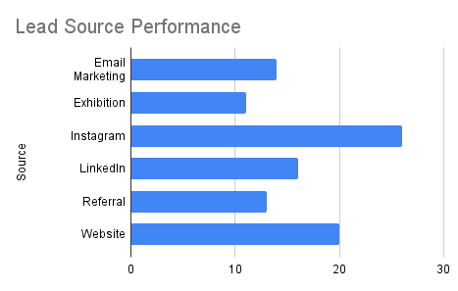
Lead Source Performance

Slide 7
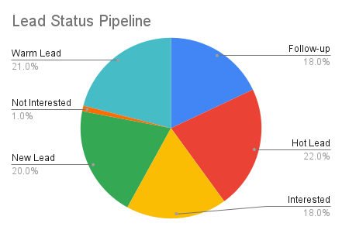
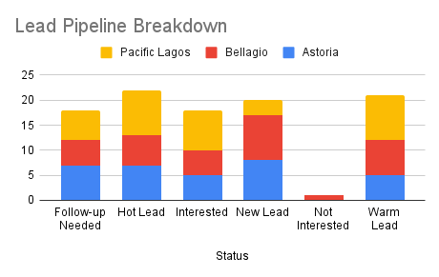
Lead Pipeline Breakdown

Slide 8
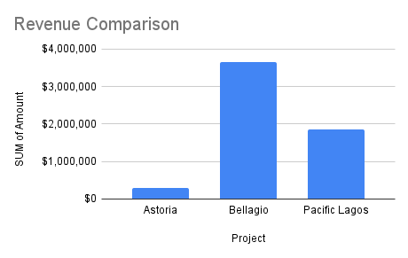
Project Revenue comparison

Slide 9
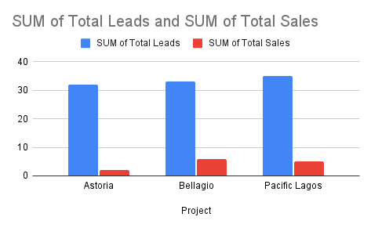
Leads Vs Sales comparison

Slide 10
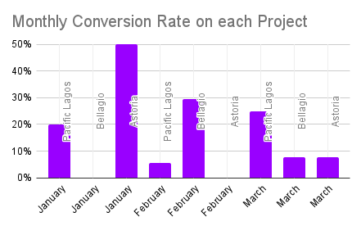
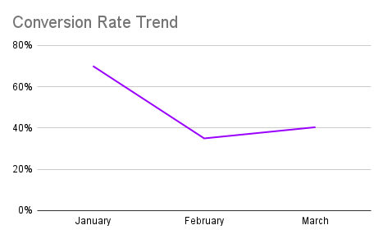
Conversion rate

Slide 11
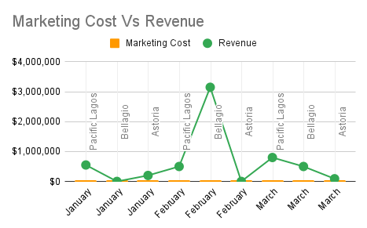
Marketing Cost Vs Revenue

Slide 12
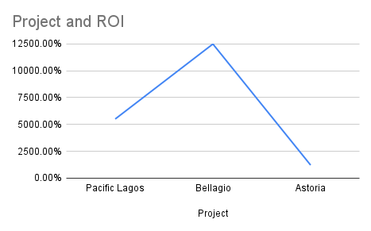
ROI Analysis

Slide 13
Recommendation
1. Strenghten Follow-up across Leads Stages
Large percentage of leads remains classifed as warm, hot, interested or Follow-up needed. Recommend structured follow-up workflow;
-Weekly sales pipeline review
-Dedicated lead ownership per sales staff.
2.Reallocate Marketing Budget Towards High-Performing Channels;
Digital sources and referrals produced the highest quality leads.
Reinvest more budget into these performing channels.
Maintain monthly ROI monitoring for each project.
3. Improve sales processes
- Astoria produce the best conversion rate. Increase marketing slightly while maintaining current lead nurturing techniques.
- Pacific Lagos shows strong inquiries but weak conversion and also strong marketing ROI(due to the value of the project). Recommend project messages and improve inspection experience.
- Bellagio also shows strong inquiries but weak conversion. Recommend strengthen project messaging and value preposition, review princing communication.
4. Optimize Client Targeting
Budget analysis shows different buyer profiles for each property.
Tailor campaigns:
Pacific - High-end shortlet investors,
Bellagio - Mid-income and high-end users,
Astoria - Investors and young professionals

Slide 14
Thank You

